Slide 1
Web scrapping using beautiful soup

Slide 2
agenda
Web scrapping
Examples
Tools available
How do collect data
Typical applications
Why we use python
Components of web scrapping
Steps to scrap data

Slide 3
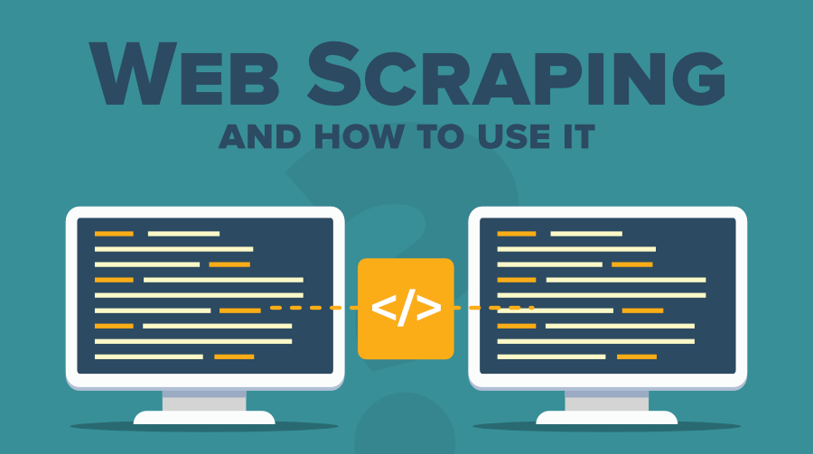
What is web scrapping
Web Scraping is a technique to extract a large amount of data from several websites.
The term "scraping" refers to obtaining the information from another source (webpages) and saving it into a local file

Slide 4
Web scrapping example
Industry share
Real Estate Listing Scraping
Comparison Shopping Sites
Social Media Sentiment Analysis

Slide 5
Tools available
Scrapping-bot
Scrapper API
Octoparse
Import.io
Webhose.io
Web Scrapper Chrome Extension

Slide 6
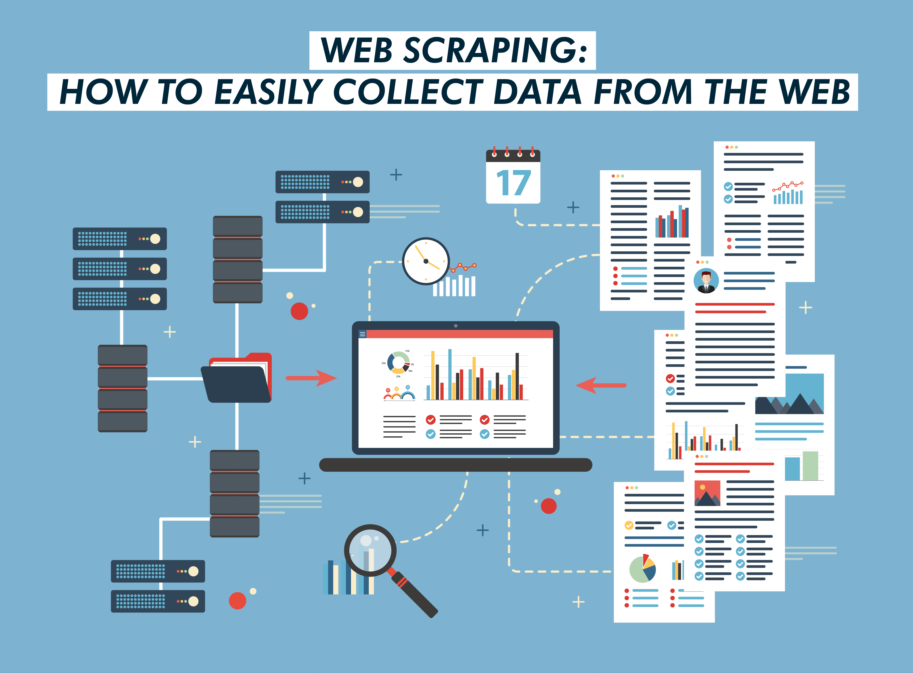
How to collect data from web ?

Slide 7
Typical applications of web scrapping
Social media sentiment analysis
eCommerce pricing
Investment opportunities
Machine learning

Slide 8
Social media sentiment analysis
The shelf life of social media posts is very little, however, when looked at collectively they show valuable trends. While most social media platforms have APIs that let 3rd party tools access their data, this may not always be sufficient. In such cases scraping these websites gives access to real-time information such as trending sentiments, phrases, topics, etc.

Slide 9
ECommerce pricing
Many eCommerce sellers often have their products listed on multiple marketplaces. With scraping, they can monitor the pricing on multiple platforms and make a sale on the marketplace where the profit is higher.

Slide 10
Investment opportunities
Real estate investors often want to know about promising neighborhoods they can invest in. While there are multiple ways to get this data, web scraping travel marketplaces and hospitality brokerage websites offer valuable information. This includes information such as the highest-rated areas, amenities that typical buyers look for, locations that may be upcoming as attractive renting options, etc.

Slide 12
Machine learning
Machine learning models need raw data to evolve and improve. Web scraping tools can scrape a large number of data points, text and images in a relatively short time. Machine learning is fueling today’s technological marvels such as driverless cars, space flight, image and speech recognition. However, these models need data to improve their accuracy and reliability. A good web scraping project follows these practices. These ensure that you get the data you are looking for while being non-disruptive to the data sources.

Slide 13
Why do we use python for web scrapping ?
Keep Your Core Message in Mind
Dynamically Typed
Vast collection of libraries
Less code
Open-Source community

Slide 14
Components of web scrapping
Crawler
A web crawler is generally called a "spider." It is an artificial intelligence technology that browses the internet to index and searches for the content by given links. It searches for the relevant information asked by the programmer
Scrapper
A web scraper is a dedicated tool that is designed to extract the data from several websites quickly and effectively. Web scrappers vary widely in design and complexity, depending on the projects

Slide 15
How does web scrapping works
Find the URL that you want to scrape
Inspecting the Page
Write the code
Store the data in the file

Slide 16
Vairavan M Naveen P Pragadiswar R Naga Sharavanesh S Sriram A Tejeshwar M Ranjith M
Team Members:

